Slide 1
01
MATLAB program to print matrix of addition add two 3 by 3 matrices

Slide 2
02
What is MATLAB?
MATLAB® is a programming platform designed specifically for engineers and scientists to analyze and design systems and products that transform our world. The heart of MATLAB is the MATLAB language, a matrix-based language allowing the most natural expression of computational mathematics.
MATLAB (an abbreviation of "matrix laboratory") is a proprietary multi-paradigm programming language and numeric computing environment developed by MathWorks.

Slide 3
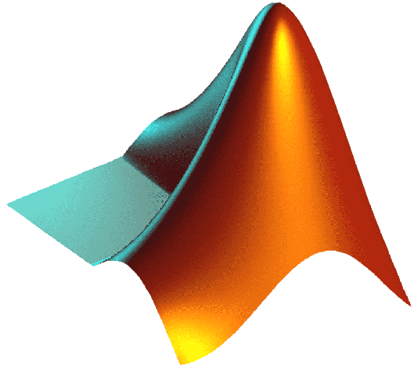
MATLAB allows matrix manipulations, plotting of functions and data, implementation of algorithms, creation of user interfaces, and interfacing with programs written in other languages.
03
MATLAB is an interactive system whose basic data element is an array that does not require dimensioning. This allows you to solve many technical computing problems, especially those with matrix and vector formulations, in a fraction of the time it would take to write a program in a scalar noninteractive language such as C or Fortran.
MATLAB was invented by mathematician and computer programmer Cleve Moler. The idea for MATLAB was based on his 1960s PhD thesis. Moler became a math professor at the University of New Mexico and started developing MATLAB for his students as a hobby. He developed MATLAB's initial linear algebra programming in 1967 with his one-time thesis advisor, George Forsythe. This was followed by Fortran code for linear equations in 1971.

Slide 4
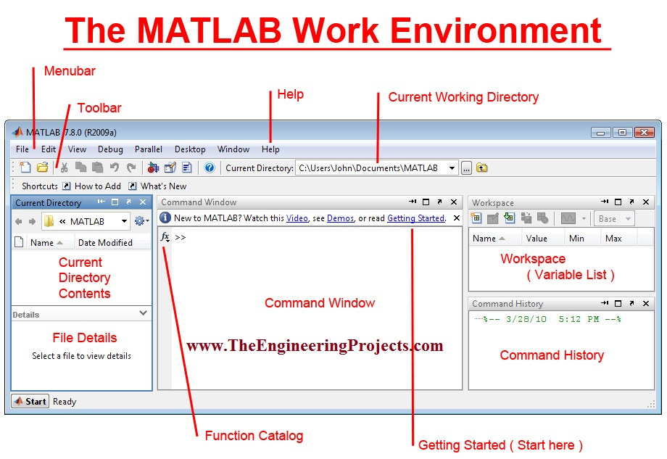
04

Slide 5
How to use MATLAB for addition of two 3x3 matrix?
05
Steps to use the command window in MATLAB and its importance in different circumstances. Command window is used to display the results of the algorithm immediately. When you do not specify an output variable whose values is desired to be obtained, then MATLAB uses a variable named as ans which is the short form of the word answer. This step is shown below.

Slide 6
The use of command window.
06
Command window is the window which displays the output in non-graphic form. The symbol >> shows that the MATLAB is ready for the input to be entered.
Matrices can be defined by separating the elements of a row with blank space or comma(,) and using a semicolon(;) to terminate each row.
I have declared three different variables (Create an array),named as a,b and addition
I have stored the value of the sum of first two variables in the third variable.
Here a = [1 2 3;4 5 6;7 8 9];
b = [9 8 7;6 5 4;3 2 1];
addition = a+b
The list of elements should be surrounded by square brackets [ ].

Slide 7
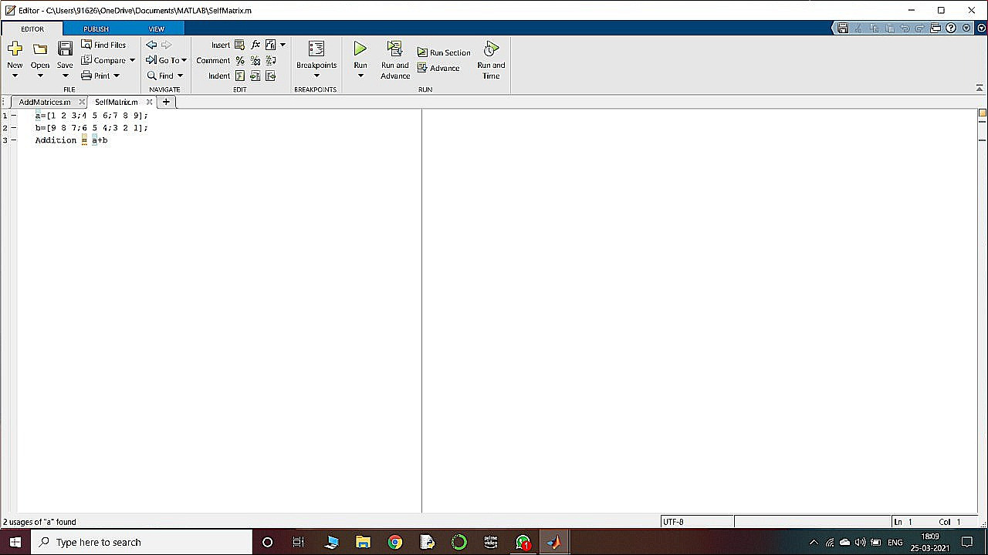
07

Slide 8
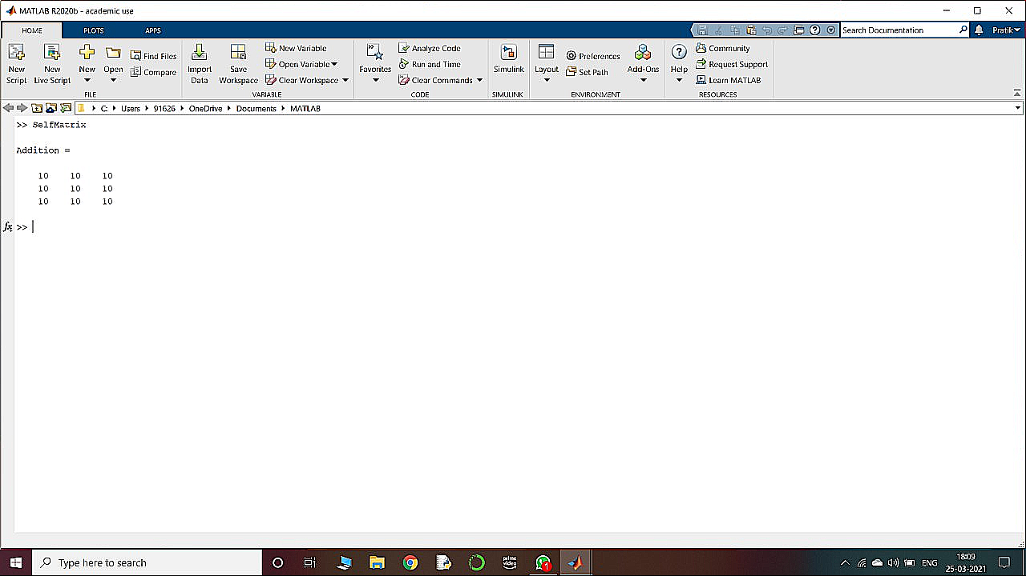
Result:-.
08

Slide 9
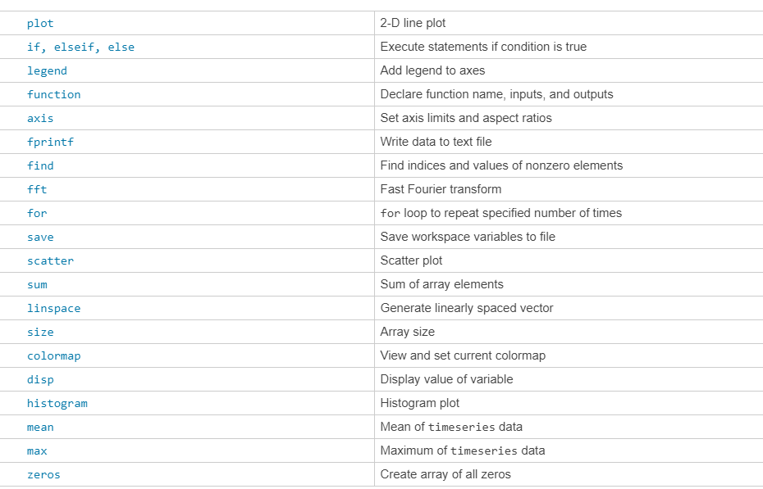
Functions in MATLAB
09

Slide 10
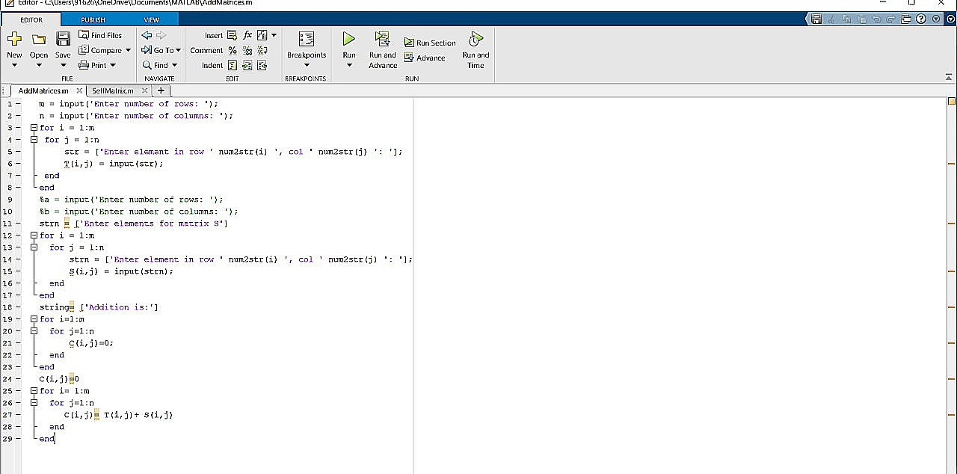
Another way to solve-
10

Slide 11
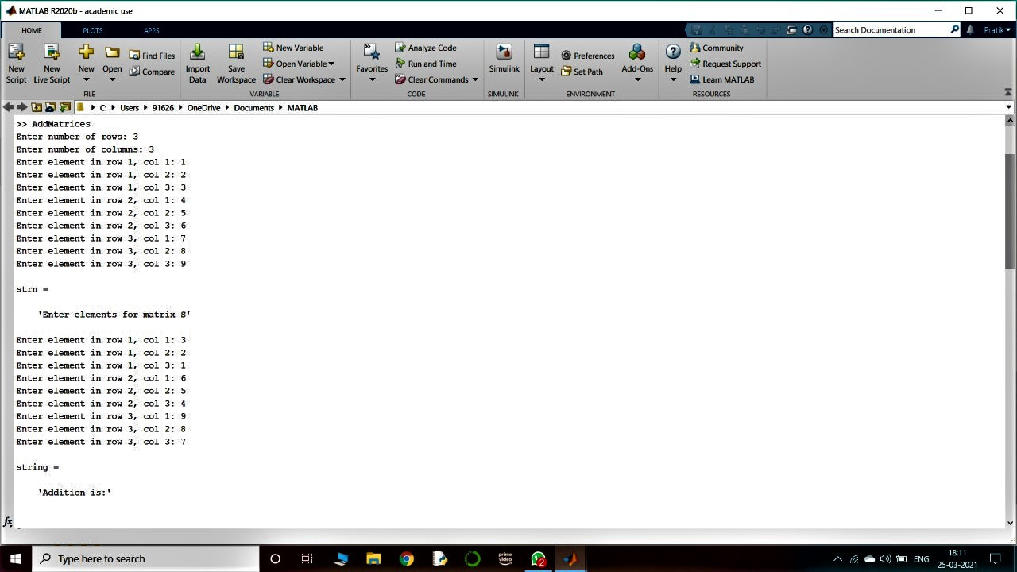
11

Slide 12
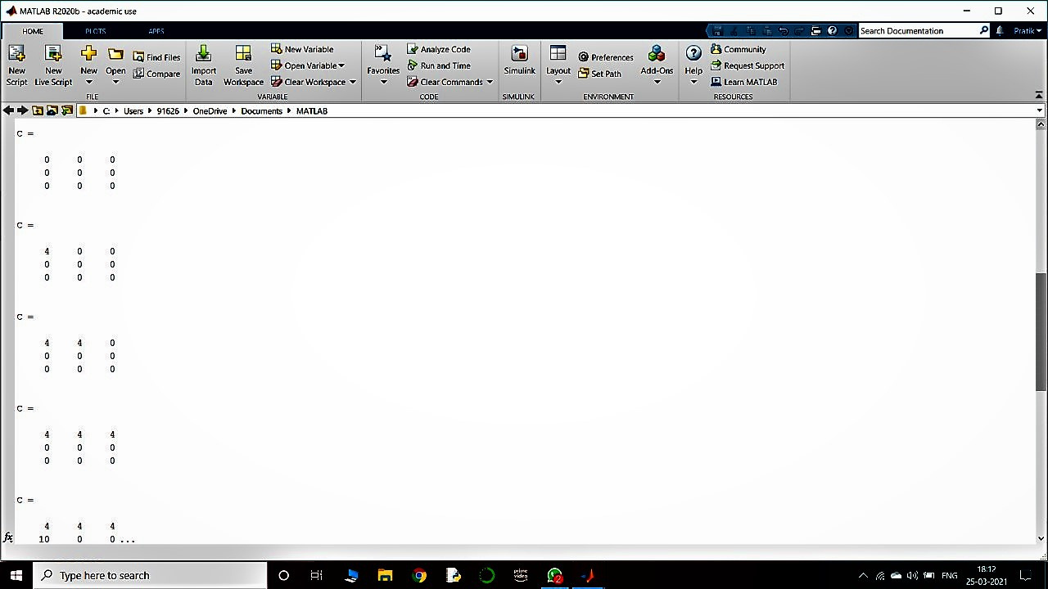
12

Slide 13
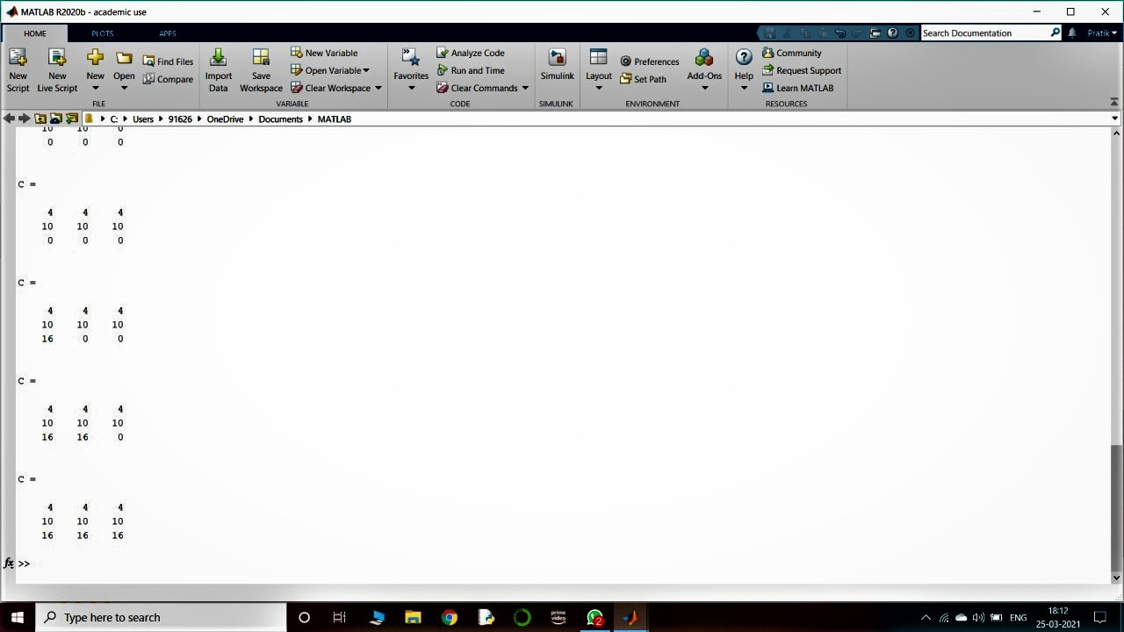
13

Slide 14
THANK YOU...

